Slide 1
INTRODUCTION TO
COMPUTER NETWORKS

Slide 2
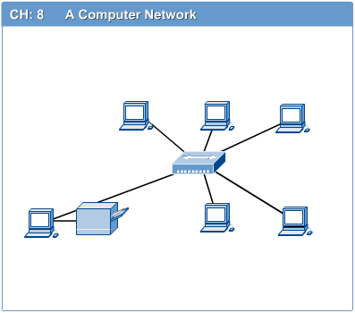
Definitions
1.1 Network Definition
A network can be defined as two or more computers connected together in such a way that they can share resources.
The purpose of a network is to share resources.

Slide 3
Definitions (cont..)
A resource may be:
A file
A folder
A printer
A disk drive
Or just about anything else that exists on a computer.

Slide 4
Definitions (cont..)
A network is simply a collection of computers or other hardware devices that are connected together, either physically or logically, using special hardware and software, to allow them to exchange information and cooperate.
Networking is the term that describes the processes involved in designing, implementing, upgrading, managing and otherwise working with networks and network technologies.

Slide 5
Advantages of networking
Connectivity and Communication
Data Sharing
Hardware Sharing
Internet Access
Internet Access Sharing
Data Security and Management
Performance Enhancement and Balancing
Entertainment

Slide 6
The Disadvantages (Costs) of Networking
Network Hardware, Software and Setup Costs
Hardware and Software Management and Administration Costs
Undesirable Sharing
Illegal or Undesirable Behavior
Data Security Concerns

Slide 7
Fundamental Network Classifications
Local Area Networks (LANs):
A local area network (LAN) is a computer network covering a small geographic area, like a home, office, or group of buildings
Wide Area Networks (WANs):
Wide Area Network (WAN) is a computer network that covers a broad area (i.e., any network whose communications links cross metropolitan, regional, or national boundaries). Or, less formally, a network that uses routers and public communications links
The largest and most well-known example of a WAN is the Internet.
WANs are used to connect LANs and other types of networks together, so that users and computers in one location can communicate with users and computers in other locations
Metropolitan Area Network (MAN):
A metropolitan area network (MAN) is a network that interconnects users with computer resources in a geographic area or region larger than that covered by even a large local area network (LAN) but smaller than the area covered by a wide area network (WAN). The term is applied to the interconnection of networks in a city into a single larger network (which may then also offer efficient connection to a wide area network).

Slide 8
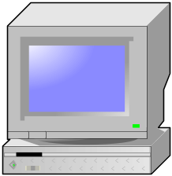

Fundamental Network Classifications (cont)
The Local Network (LAN)
Client
Client
Client
Client
Client
Client

Slide 9
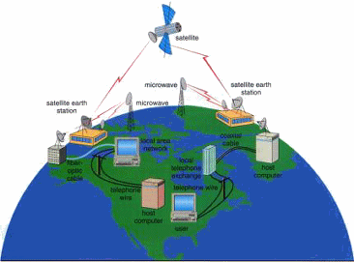
Fundamental Network Classifications (cont)
Wide Area Network

Slide 10
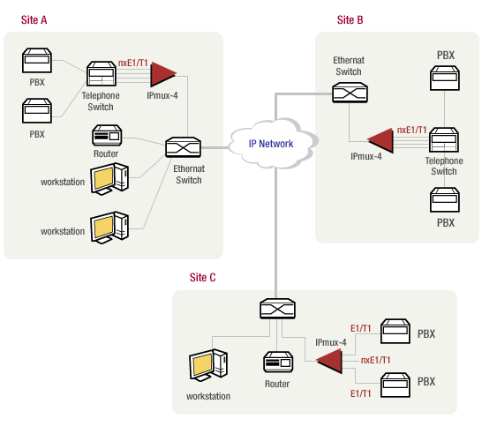
Fundamental Network Classifications (cont)
Metropolitan Area Network (MAN)

Slide 11
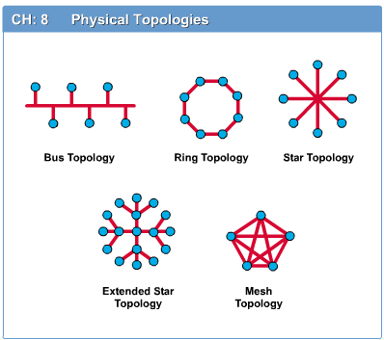
Network Topology
Introduction to Computer Networks
The network topology defines the way in which computers, printers, and other devices are connected. A network topology describes the layout of the wire and devices as well as the paths used by data transmissions.

Slide 12
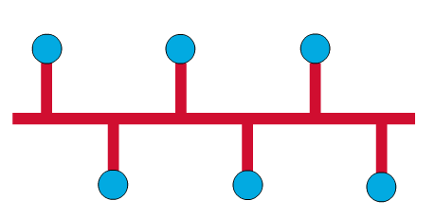
Bus Topology
Introduction to Computer Networks
Commonly referred to as a linear bus, all the devices on a bus topology are connected by one single cable.

Slide 13
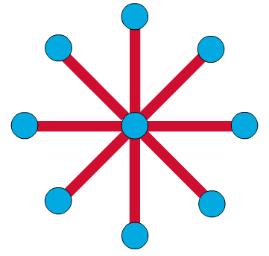
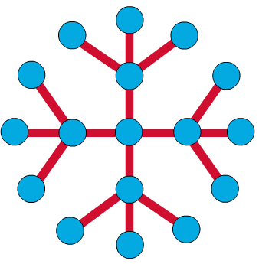
Star & Tree Topology
Introduction to Computer Networks
The star topology is the most commonly used architecture in Ethernet LANs.
When installed, the star topology resembles spokes in a bicycle wheel.
Larger networks use the extended star topology also called tree topology. When used with network devices that filter frames or packets, like bridges, switches, and routers, this topology significantly reduces the traffic on the wires by sending packets only to the wires of the destination host.

Slide 14
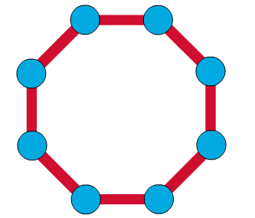
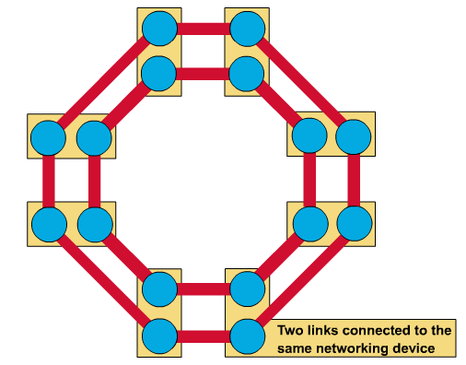
Ring Topology
Introduction to Computer Networks
A frame travels around the ring, stopping at each node. If a node wants to transmit data, it adds the data as well as the destination address to the frame.
The frame then continues around the ring until it finds the destination node, which takes the data out of the frame.
  Single ring – All the devices on the network share a single cable
  Dual ring – The dual ring topology allows data to be sent in both directions.

Slide 15
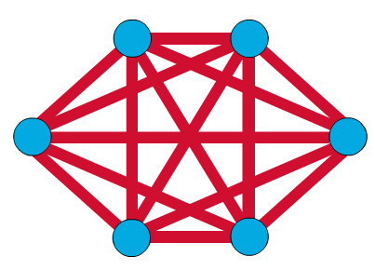
Mesh Topology
Introduction to Computer Networks
The mesh topology connects all devices (nodes) to each other for redundancy and fault tolerance.
It is used in WANs to interconnect LANs and for mission critical networks like those used by banks and financial institutions.
Implementing the mesh topology is expensive and difficult.

Slide 16
Network Components
Introduction to Computer Networks
Physical Media
Interconnecting Devices
Computers
Networking Software
Applications

Slide 17
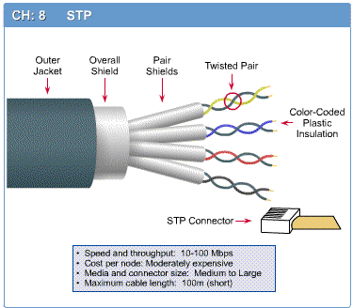
Networking Media
Introduction to Computer Networks
Networking media can be defined simply as the means by which signals (data) are sent from one computer to another (either by cable or wireless means).

Slide 18
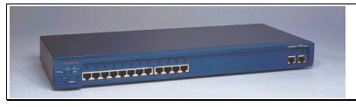
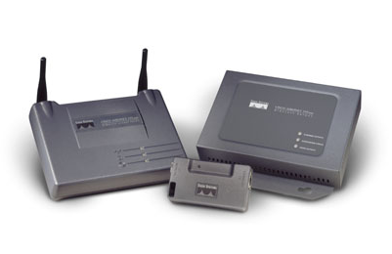
Networking Devices
Introduction to Computer Networks
HUB, Switches, Routers, Wireless Access Points, Modems etc.

Slide 19
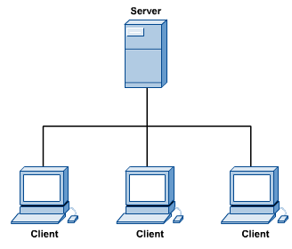
Computers: Clients and Servers
Introduction to Computer Networks
In a client/server network arrangement, network services are located in a dedicated computer whose only function is to respond to the requests of clients.
The server contains the file, print, application, security, and other services in a central computer that is continuously available to respond to client requests.

Slide 20
Intranet and Internet Specifications
Intranet: An intranet is a private network that is contained within an enterprise. It may consist of many interlinked local area networks and also use leased lines in the wide area network.
An intranet uses TCP/IP, HTTP, and other Internet protocols and in general looks like a private version of the Internet. With tunneling, companies can send private messages through the public network, using the public network with special encryption/decryption and other security safeguards to connect one part of their intranet to another.
Internet: is a worldwide system of computer networks - a network of networks in which users at any one computer can, if they have permission, get information from any other computer (and sometimes talk directly to users at other computers).

Slide 21
Client and Server computer role in networking
Server computer is a core component of the network, providing a link to the resources necessary to perform any task.
A server computer provides a link to the resources necessary to perform any task.
The link it provides could be to a resource existing on the server itself or a resource on a client computer.
Client computers normally request and receive information over the network client. Client computers also depends primarily on the central server for processing activities

Slide 22
Peer-to peer network
A peer-to-peer network is a network where the computers act as both workstations and servers.
great for small, simple, and inexpensive networks.
In a strict peer-to-peer networking setup, every computer is an equal, a peer in the network.
Each machine can have resources that are shared with any other machine.
There is no assigned role for any particular device, and each of the devices usually runs similar software. Any device can and will send requests to any other.

Slide 23
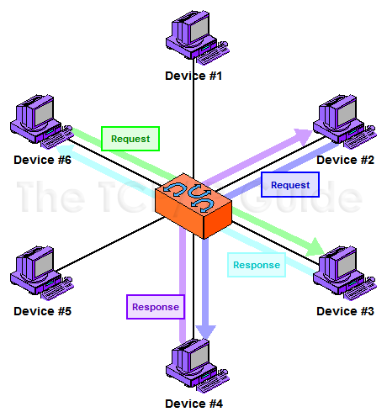
Peer-to peer network (cont..)

Slide 24
Client/Server Networking
In this design, a small number of computers are designated as centralized servers and given the task of providing services to a larger number of user machines called clients

Slide 25
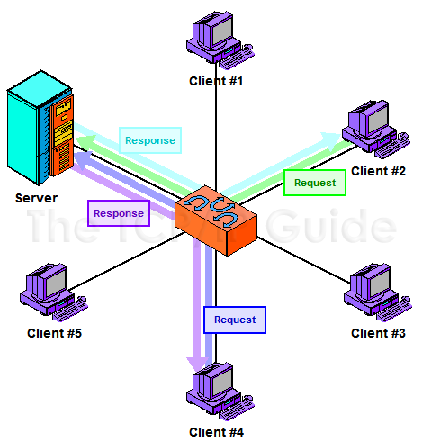
Client/Server Networking (cont..)

Slide 26

Applications
Introduction to Computer Networks
E-mail
Searchable Data (Web Sites)
E-Commerce
News Groups
Internet Telephony (VoIP)
Video Conferencing
Chat Groups
Instant Messengers
Internet Radio

